Slide 1
NATURAL GAS PIPELINE INFORMATION

Slide 2
Course Overview
The Liberty pipeline response course is designed to provide awareness for emergency responders who may respond to a pipeline incident involving one of Liberty’s assets.
Note: This is a general guide, and any further questions can be directed to local staff.
Notes:
Federal pipeline safety regulations (49 CFR 192.616 and 49 CFR 195.440) require pipeline operators to develop and implement public awareness programs that follow the guidance provided by the American Petroleum Institute (API) Recommended Practice (RP) 1162, "Public Awareness Programs for Pipeline Operators" (incorporated by reference in federal regulations).
API RP 1162 is an industry consensus standard that provides guidance and recommendations to pipeline operators for the development and implementation of enhanced public awareness programs. It addresses various elements of such programs, including the intended audiences, the kinds of information to be communicated, frequencies and methodologies for communicating the information, and evaluation of the programs for effectiveness

Slide 3
Liberty is a provider of safe and reliable energy to communities from coast to coast
Liberty goes above and beyond traditional energy services, with Economic Development resources that provide the support, knowledge, and opportunity to help the towns, and cities we serve to thrive
About Liberty

Slide 4
Pipeline purpose and reliability

Slide 5
Role of pipelines in U.S. energy supply
Pipelines are the safest and most efficient method to transport the energy that we need and use every day.
Our pipelines and pipeline facilities are built using industry best practices, which include using the highest quality materials during construction and implementing a rigorous pipeline maintenance program. This includes the facilities required to safely operate the pipeline, like meter stations and compressor stations.

Slide 6
Energy transportation pipeline safety record
We aim for our pipelines and facilities to operate incident-free and to ensure our assets serve our people and communities across the continent for years to come.
Pipelines are the safest, most environmentally friendly way to transport natural gas and petroleum- period. Our pipeline safety programs are among the most robust in the industry and are the most important part of our business. From pipeline integrity innovations to investing in leak detection technology and public awareness programs, safety is the common link behind everything we do.

Slide 7
Federal & State regulatory agencies
The Pipeline and Hazardous Materials Safety Administration (PHMSA) regulates interstate pipelines in the United States. The following is a list of state regulatory agencies that oversees pipelines within their state.

Slide 8
Federal & State regulatory agencies
Arkansas
Arkansas Public Service Commission
https://apsc.arkansas.gov/utilities/pipeline-safety/
Illinois
Illinois
Illinois Commerce Commission
https://www.icc.illinois.gov/home/Illinois-Gas-Pipeline-Safety-Program
Iowa
Iowa Utilities Board
https://iub.iowa.gov/regulated-industries/pipeline-permits-certifications/pipeline-safety
Kansas
Kansas Corporation Commission
https://www.kcc.ks.gov/natural-gas-pipeline-safety-liquid-pipeline
Missouri
Missouri Public Service Commission
https://psc.mo.gov/General/Pipeline_Safety

Slide 9
Hazard Awareness and Prevention Measures

Slide 10
Overview of potential hazards of a gas release
Natural gas is extremely flammable and may explode if heated, natural gas may also displace oxygen and cause rapid suffocation.

Slide 11
Causes of Pipeline Failures
Although pipeline incidents are relatively rare, accidents do occur.
The leading cause of pipeline accidents happen because third-party excavators do not call 811 for the proper locations of the pipe before they start digging.
Even minor excavation activities can cause damage to a pipeline, it’s protective coating or to other buried utility lines.
Corrosion, material defects, worker error and events of nature can also be causes of pipeline failures.

Slide 12
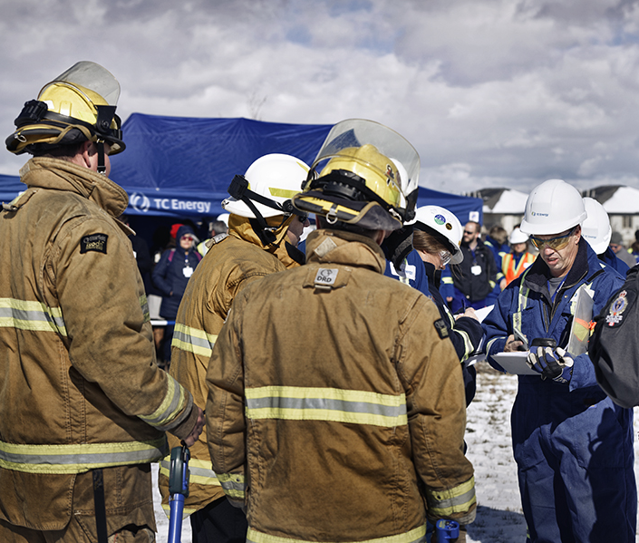
Types of TC Energy Pipelines
We build and operate safe and reliable energy infrastructure.
Product Release Characteristics
Natural gas is an energy source composed mostly of methane.
Natural gas is said to be odorless, but some people detect a slight hydrocarbon smell. If the gas has been odorized, it could smell skunk-like or similar to rotten eggs. Natural gas is highly flammable and explosive.

Slide 13
Potential hazards from an accidental gas release
Dizziness or suffocation if a leak occurs in a confined space or high concentration.
Ignition/fire if a spark or other ignition source is present.
Potential explosion if the natural gas is mixed with air.
Projectiles from site of leak or rupture propelled by the force of escaping gas.
In the event of a natural gas pipeline release, the environment may be impacted and could result in injuries or fatalities as well as damage property.

Slide 14
This includes but is not limited to:
24/7 monitoring of our facilities.
In-line inspections of pipelines that can identify the smallest issues or defects for repair.
Regular patrols of the right-of-way.
Multiple shut-down valves to isolate and limit potential releases.
Cathodic protection to prevent corrosion.
Hydrostatic testing.
Investigative digs.
Ground surveys.
Prevention measures undertaken
Liberty conducts a rigorous pipeline maintenance program to ensure the integrity and safety of our systems.

Slide 15
Leak recognition and response

Slide 16
Recognizing a gas pipeline leak
Although a pipeline leak is rare, it is important to know how to recognize the signs. Use your senses of sight, smell and hearing to detect a potential pipeline leak.
You might see:
You might smell:
You might hear:
Dead or dying vegetation on/near the right-of-way in an area that is usually green.
Bubbles in a body of water.
Dirt being blown into the air.
Ground frosting in summer.
Possible fire or flames above the ground, if the leak has been ignited.
Natural gas transmission lines are not usually odorized, though smaller gas distribution lines often have an additive to give it a Sulphur or “rotten egg” smell.
A roaring, hissing or whistling noise.

Slide 17
Liberty’s Response to a Pipeline Incident
In the unlikely event an incident should occur, Liberty’s top priorities are to ensure the safety of the public and Emergency Responders, and to minimize effects on the environment and surrounding properties.
Liberty will immediately respond by:
Shutting down the affected pipeline if necessary.
Isolating the impacted section of the pipeline through either automatic valve shutoff or manual valve operation.
Dispatching emergency personnel to the location of the incident.

Slide 18
Emergency Responders response to a pipeline incident
Isolate spill or leak area for at least 330 feet.
Keep unauthorized personnel away.
Stay upwind.
Eliminate all ignition sources.
All equipment used when handling the product must be grounded.

Slide 19
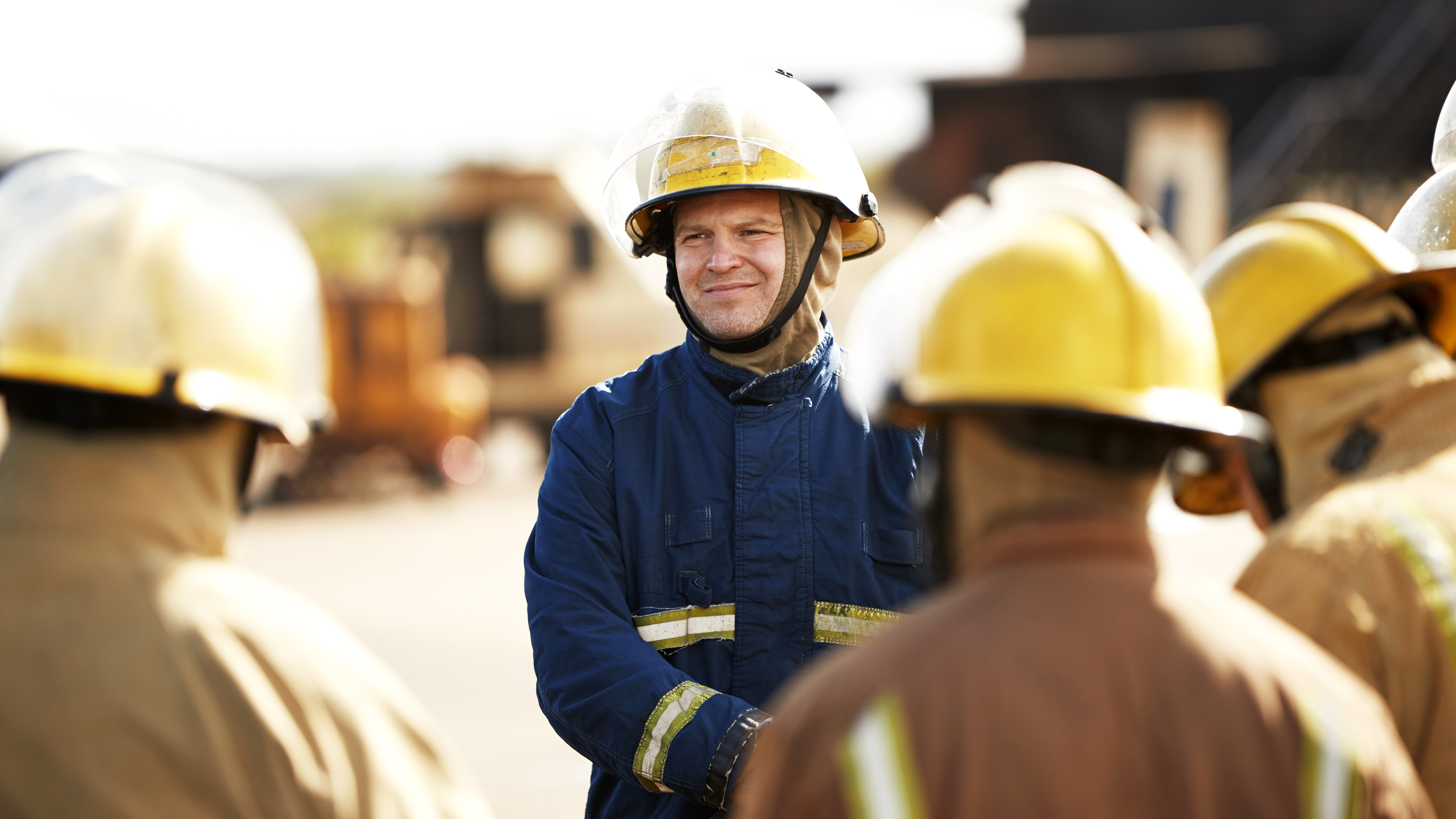
Liberty Liaison with Emergency Officials

Slide 20
Learn the responsibility and resources of each government organization that may respond to a facility emergency.
Acquaint officials with the Company’s ability to respond to a facility emergency.
Identify the types of facility emergencies in which they may be notified.
Plan how the Company and Emergency Officials can engage in mutual assistance that will minimize hazards to life and/or property.
Liberty shall establish and maintain a liaison with appropriate fire, police and other public officials to:
Notes:
This contact is generally established through the public awareness meetings schedules under the Public Awareness Program but shall be augmented with consultation during ERP development and invitation of Emergency Services to field exercises.

Slide 21
Emergency preparedness communications

Slide 22
Liberty’s priority to protect life
Liberty makes a continuous effort to ensure the Emergency Response Plan is executed to protect life, preserve the environment, and communicate the status of an emergency to all stakeholders.

Slide 23
Emergency preparedness and response plans
Liberty’s Emergency Management Program focuses on two key objectives:
Promote an emergency preparedness culture.
Execute effective and expeditious emergency response.
Liberty develops and maintains state of the art emergency preparedness and response systems with the objectives of controlling, mitigating and minimizing the impact of emergencies to life safety, property and the environment.

Slide 24
Emergency preparedness and
response plans
Liberty’s Emergency Management Program applies (as appropriate) the Emergency Management Standard and Emergency Management Process, using applicable procedures, across all assets operated by Liberty affiliates.
PLAN
PREPARE
RESPOND
EVALUATE & IMPROVE
Assess
Activate Response
Mobilize Resources
Execute & Monitor Response
Stand Down
This image shows the relationship between emergency preparedness and emergency response within Liberty.

Slide 25
Types of TC Energy Pipelines
We build and operate safe and reliable energy infrastructure.
Emergency response drills and exercises
The Company requires routine emergency response exercises to test the accuracy and effectiveness of Emergency Response Plans.
An exercise is defined as a simulation of an actual emergency; simulation enables employees to learn by practicing their emergency response roles and skills. Exercises also provide the opportunity to learn and to problem solve, avoiding potential issues and concerns during an actual emergency.

Slide 26
Pipeline location information
The general location of pipelines can be determined by two characteristics:
a pipeline right-of-way (ROW)
pipeline markers

Slide 27
Right-of-way (ROW)
A ROW can usually be recognized as a clear strip of land in a linear or fairly straight line, cleared of structures and trees.
The ROW contains the pipeline and a buffer area that usually extends 25 feet or more on either side of the pipeline where certain activities are restricted to ensure the continued safety and integrity of the pipeline.
The ROW must be kept clear of fences, buildings, trees or any other type of structure. The impact of a fence post, weight of a shed or the roots of a tree can cause either immediate or long-term damage to the pipeline.
These could also impede access to the area for any required maintenance or emergency situations, resulting in safety risks and possible costly impacts to structures on the ROW.

Slide 28
Pipeline markers
Found within line-of-sight on a ROW and at locations where the pipeline crosses streets, highways, waterways and railways.
Markers only show the approximate location of the pipeline, and the depth of the line may vary. You cannot use pipeline markers as a determination of where or where not to dig.
Pipeline markers display the pipeline operator, emergency number and the product transported in the pipeline.
It is against the law to willfully deface, damage, remove or destroy and pipeline sign.
Only a Liberty representative can determine the location and depth of the pipeline. Pipelines may not follow a straight course between marker signs.

Slide 29
National Pipeline Mapping System
Best way to view where Liberty assets run through specific counties.
Search for pipeline operator contact information in a selected county, state or zip code.
Transmission lines only.
www.npms.phmsa.dot.gov
Notes:
Having awareness of pipelines located in your district is crucial. For information on transmission pipelines, you can visit the National Pipeline Mapping System website. The site is useful for pre-planning in your community.

Slide 30
In accordance with federal regulations, some segments along Liberty’s pipelines have been designated as High Consequence Areas (HCAs) where extra precautions are taken, known as Integrity Management Programs.
A message about High Consequence Areas (HCAs)
A high consequence area is defined as a location in pipeline safety regulations where pipeline releases could have greater consequences to health and safety or the environment.

Slide 31
Additional information on company website
For additional information about Liberty pipelines and to connect with your Liberty representative, please visit:
https://libertypipelineresponse.com/
Notes:
Federal pipeline safety regulations (49 CFR 192.616 and 49 CFR 195.440) require pipeline operators to develop and implement public awareness programs that follow the guidance provided by the American Petroleum Institute (API) Recommended Practice (RP) 1162, "Public Awareness Programs for Pipeline Operators" (incorporated by reference in federal regulations).
API RP 1162 is an industry consensus standard that provides guidance and recommendations to pipeline operators for the development and implementation of enhanced public awareness programs. It addresses various elements of such programs, including the intended audiences, the kinds of information to be communicated, frequencies and methodologies for communicating the information, and evaluation of the programs for effectiveness

Slide 32
Questions?

